Slide 1
Isolation and phylogenetic characterization of full genome Astroviruses from Malagasy fruit bats

Slide 2
Feedback
Main takeaways (‘result’) from each figure
Implicates of takeaways (‘discussion’)
Figure aesthetics feedback
Main message (‘title’)

Slide 3
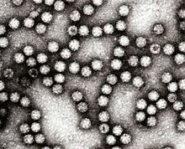
Astroviruses
Discovered in 1975
Positive, single sense, single stranded RNA
2 genera
Mamastrovirus: mammals! Humans
Avastrovirus: birds
Cause gastroenteritis
Children (5-9%), elderly
90% seroprevalence
Fecal-oral route
Diverse range of hosts, suggesting frequent cross-species transmission

Slide 4
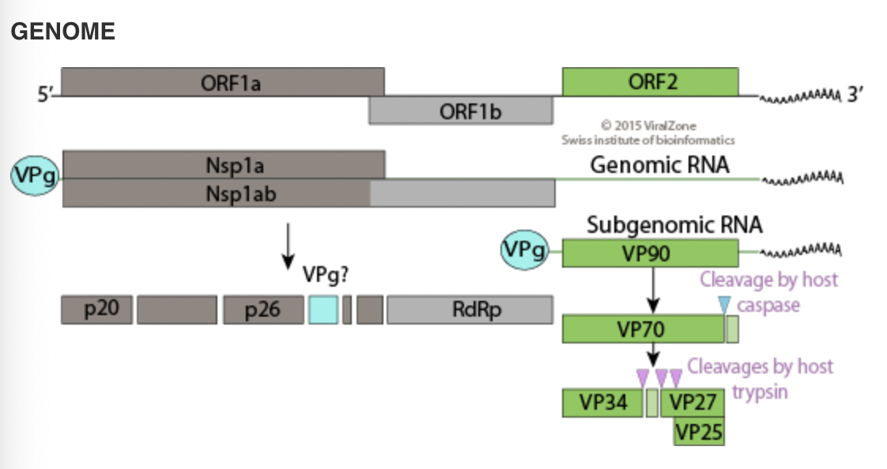
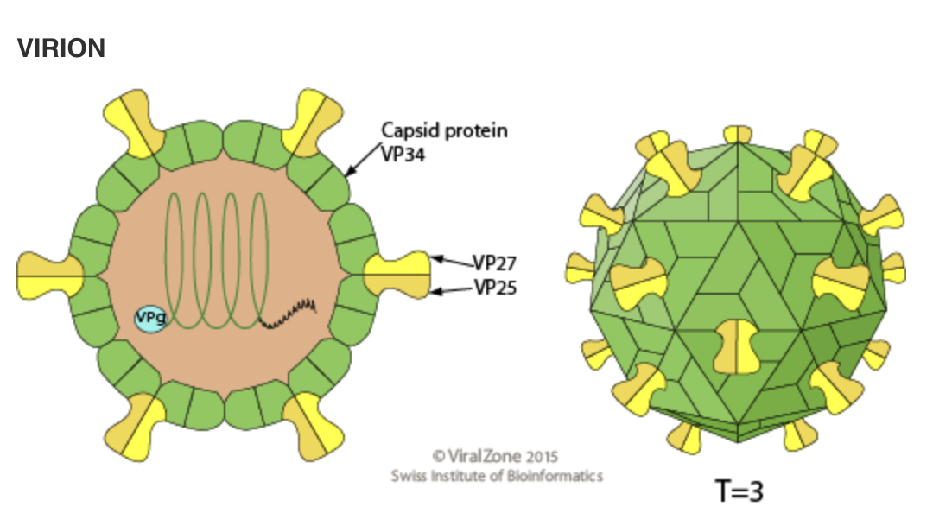
Virus structure
Notes:
-orf2 is the binding site

Slide 5
Astroviruses in bats
Documented in many bat species
Only 4 full genomes (2x Denmark, Cameroon, USA)
“neglected virus family”
High genetic diversity is common in bat AstV’s
Lebarchenon 2017
Sampling bats at Ambohitantely and Anjohibe
22.5% positivity
6/9 spp positive
*Malagasy bats may act as reservoirs of a large diversity of AstVs

Slide 6
Narrative flow
Astroviruses are understudied, but important
Symptoms
Frequent cross-spp transmission
Bats are key organisms for virus surveillance
Host many viruses
Bat-human interactions
Madagascar a particularly interesting place to look for astroviruses
Divergence
Bat consumption

Slide 7
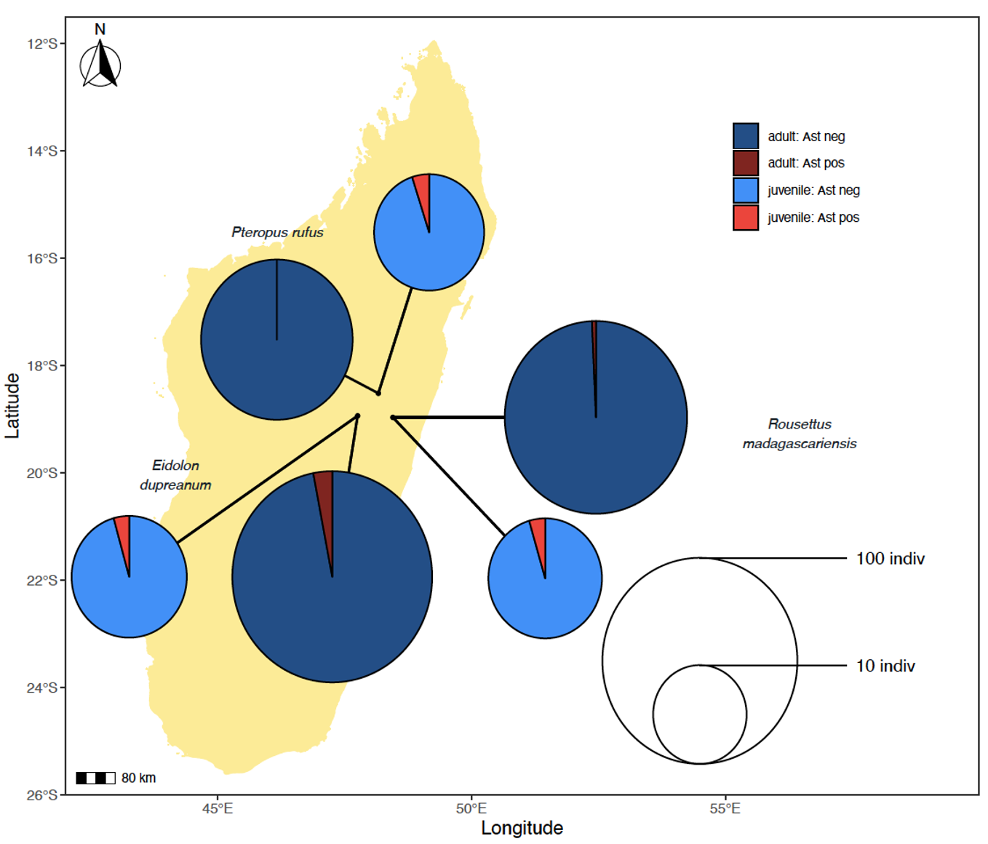
4/285 (1.4%) fecal samples
7/196 (3.57%) urine samples
1/44 (2.27%) P. rufus
8/145 (5.52%) E. dupreanum
2/96 (2.08%) R. madagascariensis
Juv vs adult
1/15 (6.66%) vs 0/29 (0%) P. rufus
1/13 (7.69%) vs 7/132 (5.30%) E. dup
1/13 (7.69%) vs 1/83 (1.20%) R. mada
Low detection, but in all species, all locations
Important for potential zoonotic spillover
More in juvenile than adult
Astros typically a human child thing..
More sampling needed (locations, bats)
Notes:
is detection in urine normal?

Slide 8
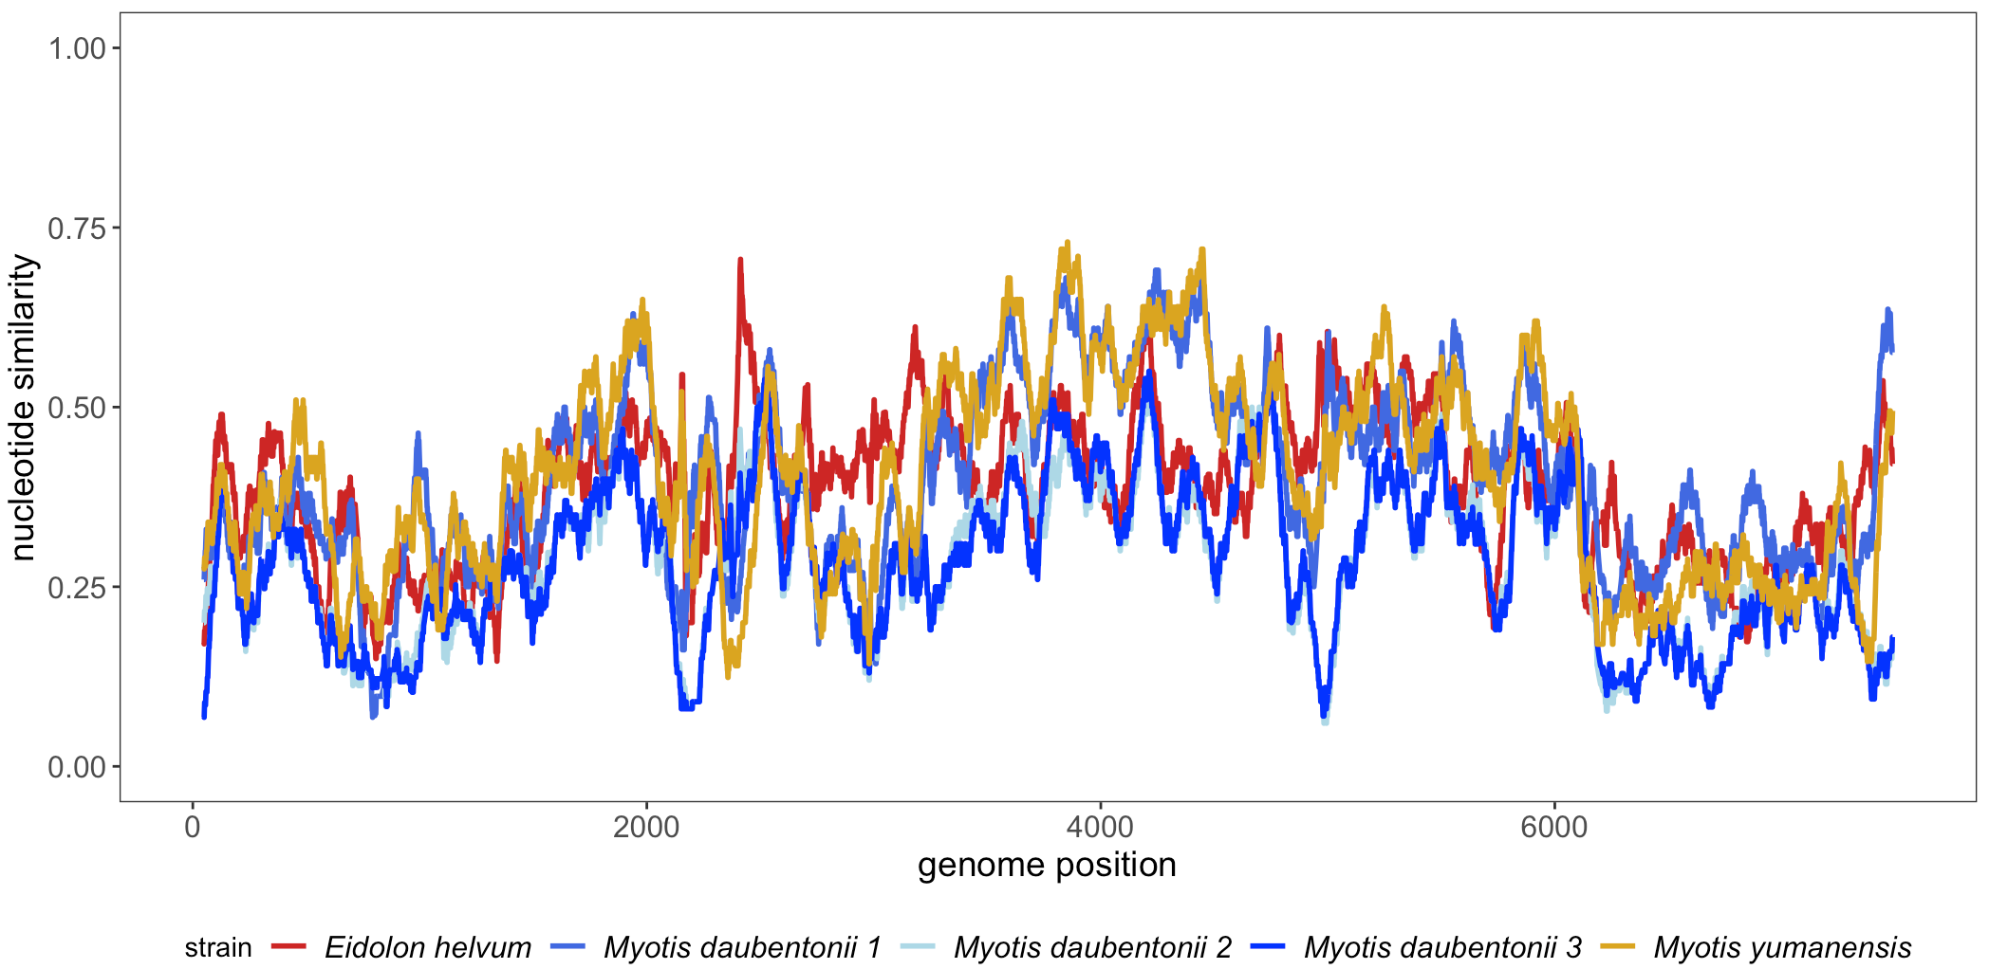
Nucleotide similarity plot
Query: one of our novel full-genomes
Comparison: other novel full, all other full genomes from bats
Most similar is other novel (mean = 79.57%)
All others cluster together, with range of mean from 27.95% - 41.26%
Novel are very divergent sequences, even though there is substantial geographic variation represented in other samples (Cameroon, USA, Denmark)
Isolated evolution? Evolved more recently? More sampling needs to be done across other geographic areas?

Slide 9
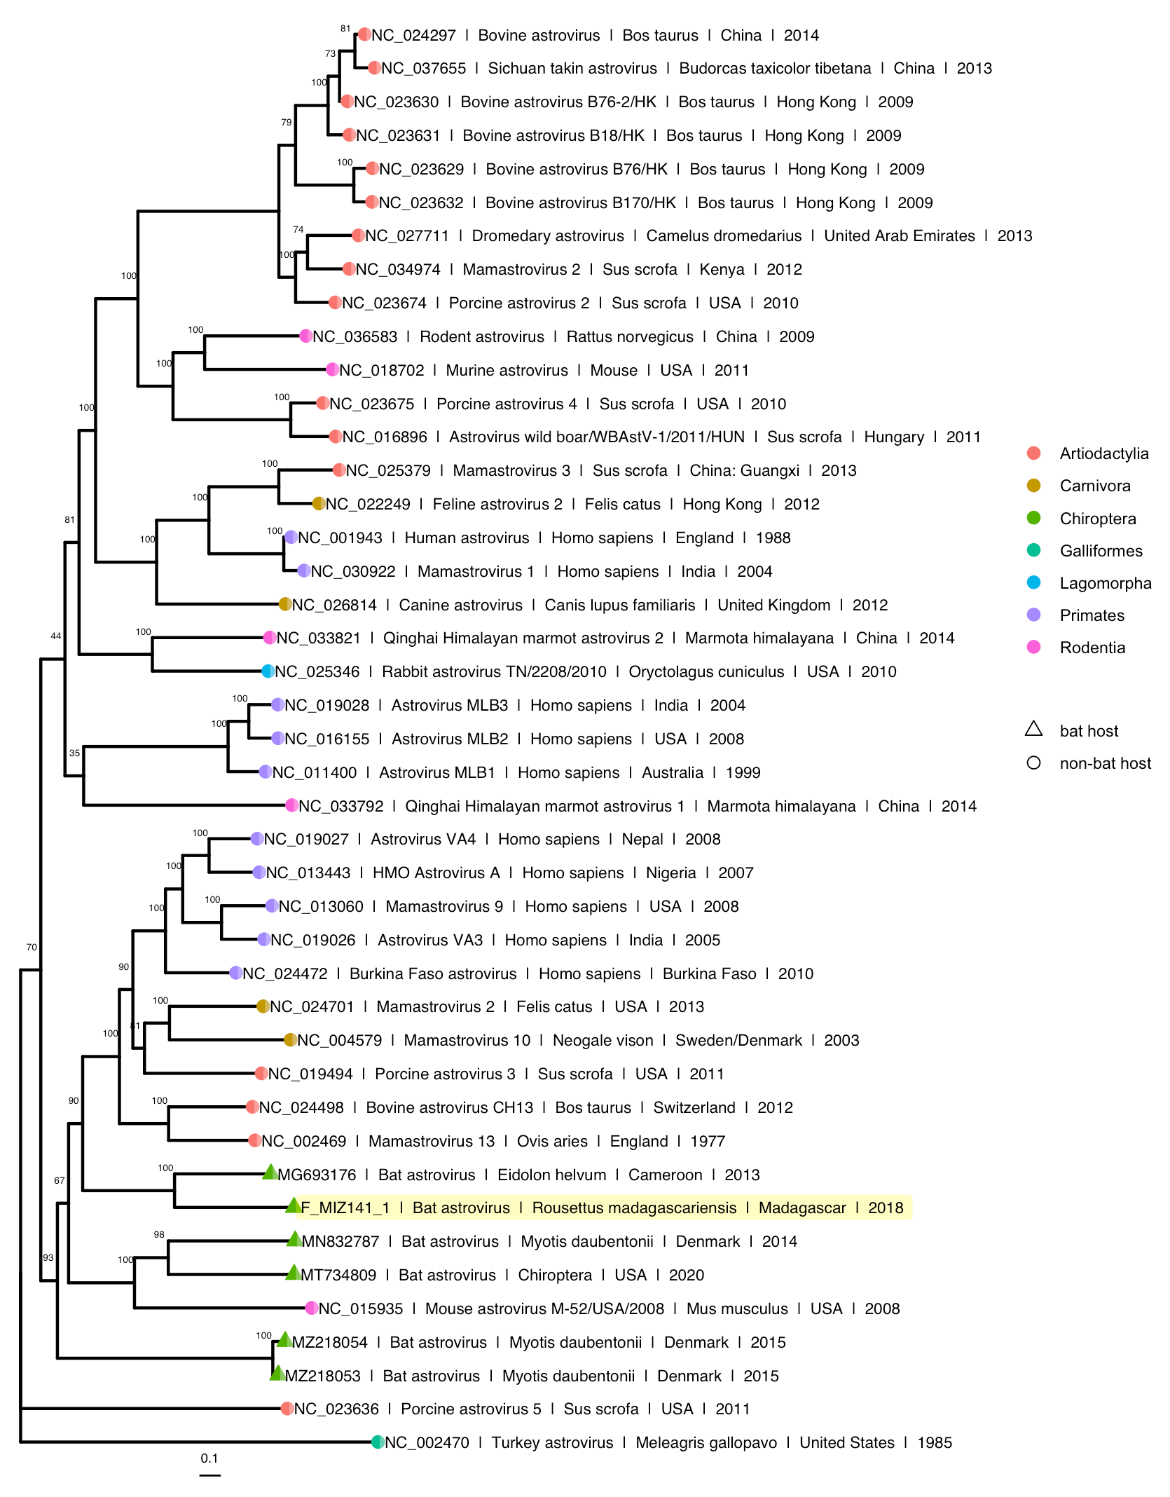
Novel astroviruses most closely related with each other (duh?)
Closest to our clade is E. helvum from Cameroon
Pteropodid and location
Chiroptera is paraphyletic
Recently diverged from one another
Basal to group containing Artiodactylia, Carnivora, Primates (humans)
Paraphyly indicative of frequent cross-species transmission (classic of astroviruses)
Again, divergence of Madagascar seqs

Slide 10
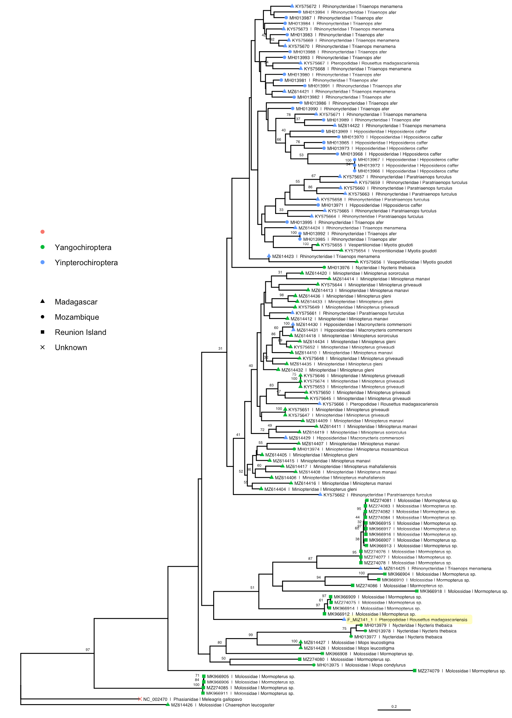
Our seqs fall out in somewhat basal clade
Most basal yin
Closest to reunion island insectivorous bats
Only other mada or pteropodid in clade is Rhinocyteridae
Relationships follow phylogeny more than location
Except non-monophyletic yang
Except yinpteropchiroptera seems to be more mixed in than yangochiroptera
Astroviruses have been in bats a long time (phylogeny over location)
Something special about yinp
More likely to get Astros from yang than the other way around
Fewer? Communal roosting?
Could just be a lack of sampling
Larger clade support values aren’t super strong

Slide 11
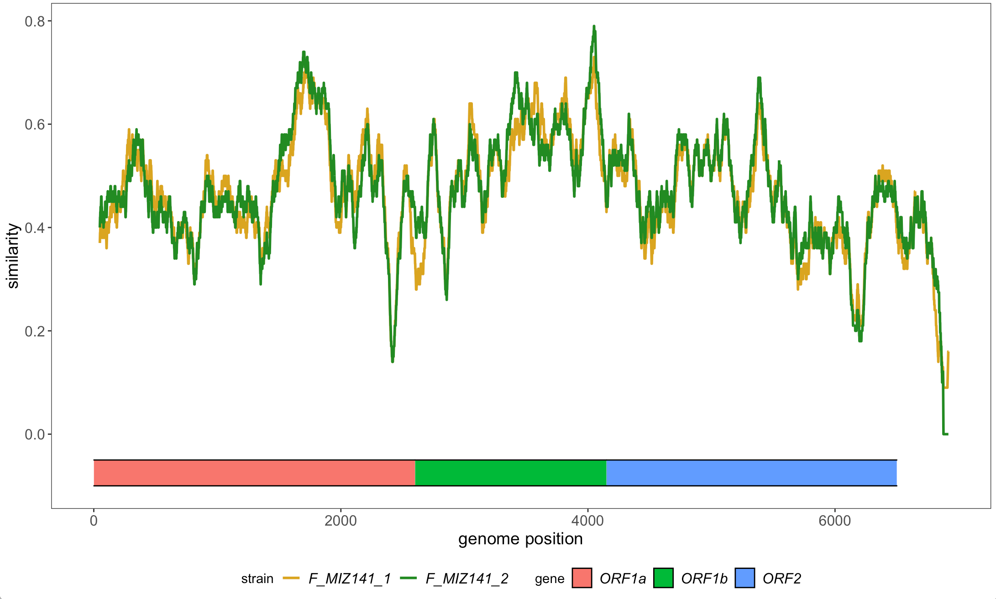
Nucleotide similarity plot
Query: closest related human astrovirus
Comparison: both novel astrovirus seqs
Average similarity 46.88% and 47.32%
ORF2 contains spike protein, most relevant for zoonotic potential
Because similarity is low (cite), not strong zoonotic potential

Slide 12
Bayesian timetree
Coming soon

Slide 13
Interesting Insights
Astroviruses appear to be widespread in low levels among bats
Lebarchenon
Two full genome astroviruses (bats from 4 – 6)
Coinfection from a single individual
Sequences are highly divergent
Possibly differences in yin vs yang crossover

Slide 14
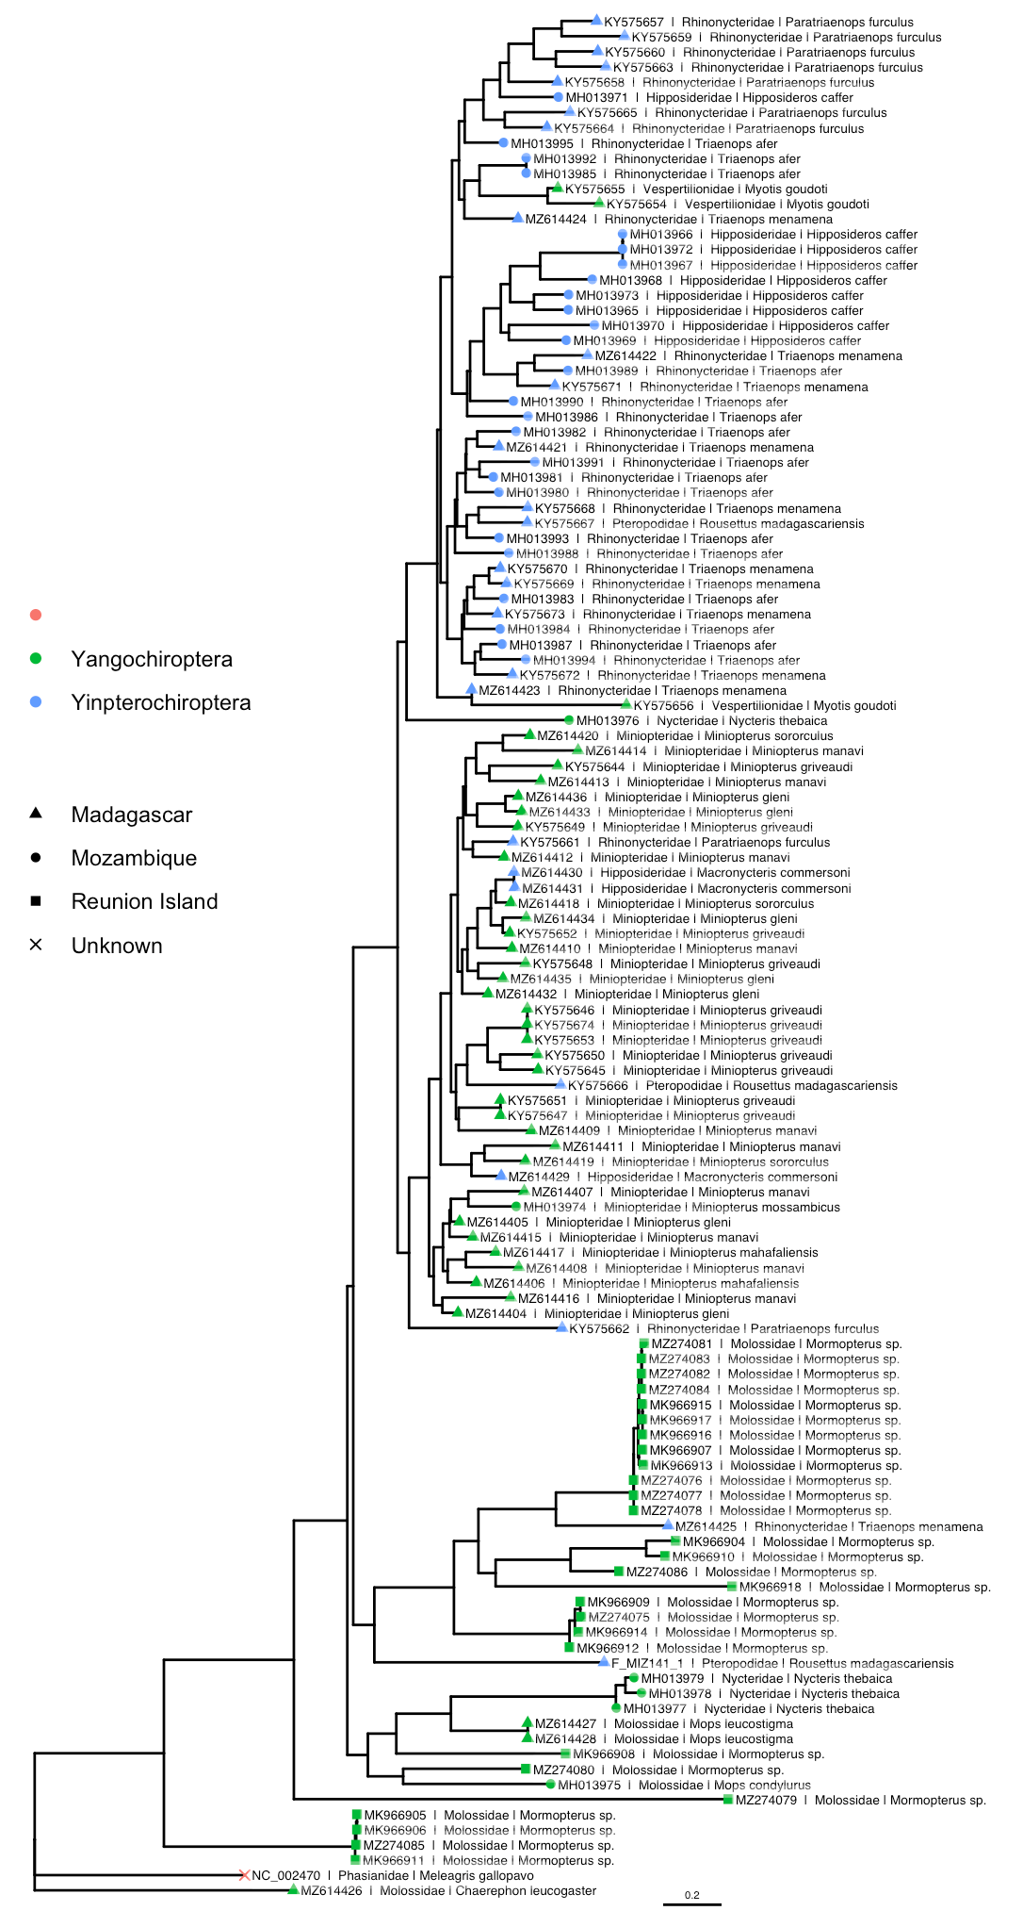
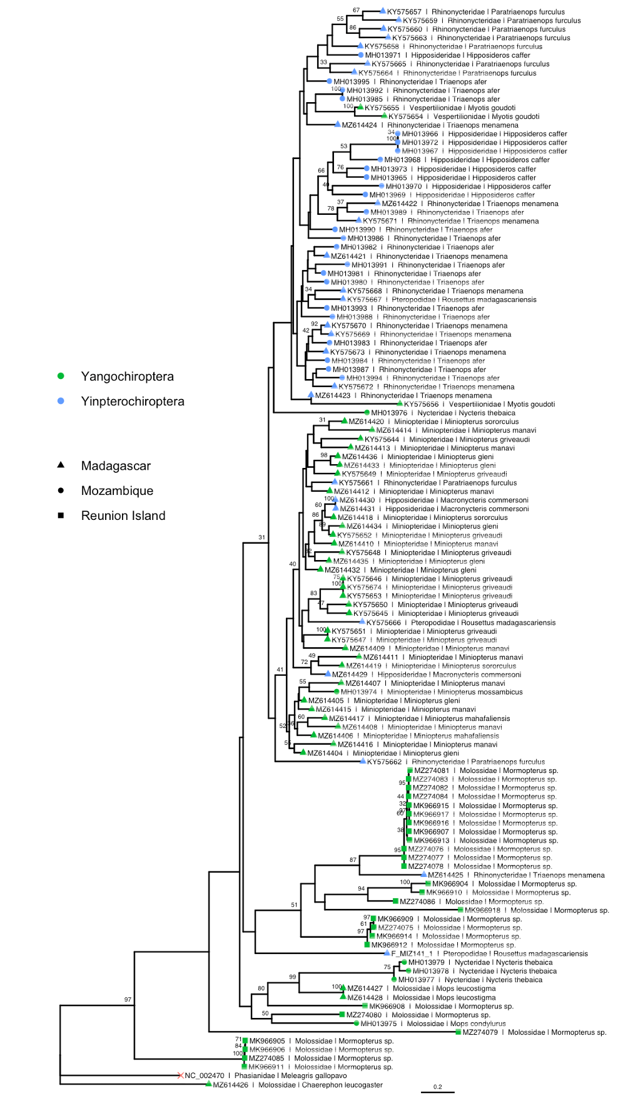
Notes:
Left (TBE) Right (FPB)

